Slide 1
Formatted Input/Output

Slide 2
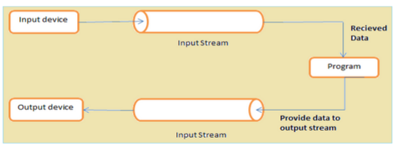
Input/Output (I/O)
I/O in C is done through streams
Input stream for input (e.g. the keyboard)
Output stream for output (e.g. the screen)
Other streams can be used
Need to #include <stdio.h>

Slide 3

Formatted Output
printf is your go-to output function (print formatted)
Can print strings, variables, etc.
You can modify the output using Format Specifiers, the general form of this being:
%[flags][width][.precision]specifier

Slide 4
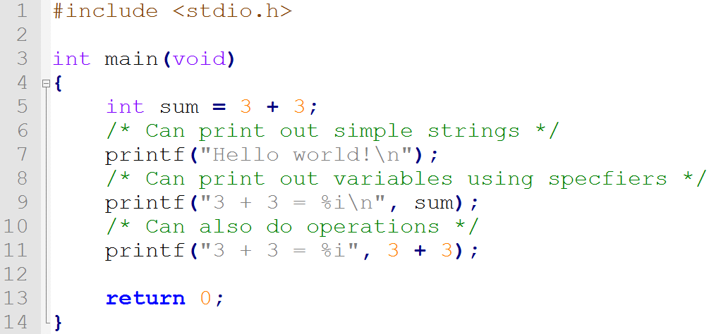
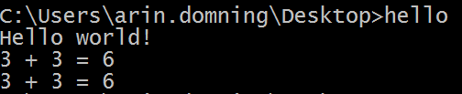
Examples
C code
Output

Slide 5
Specifiers - Required
Type of the data
Common specifiers:
d – signed integer (not double!)
i – signed integer
f – floating point (float and double)
e – scientific notation
g – floating point with minimum digits
c – characters (char)
s – strings

Slide 6
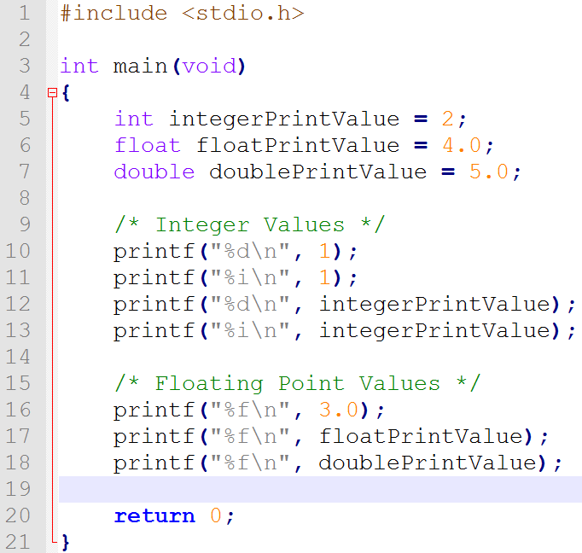
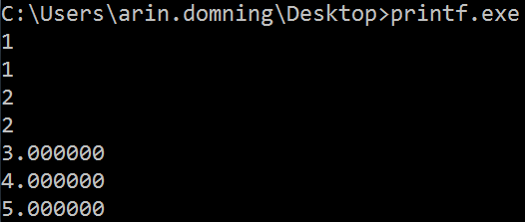
Specifier Examples
C code
Output

Slide 7
Flags - Optional
A symbol
- (minus) – Left-align the output within the given field width (Right-align is default)
+ (plus) – Places a plus sign before positive numeric values (Default does not prepend)
(space) – Places a space before positive numeric values. Ignored if + flag exists (Default does not prepend)
0 (zero) – When the ‘width’ option is specified, places zeros before numeric types (Default prepends spaces)
# (hash) –
For g-specified types, trailing zeros are not removed
For g, e, and f-specified types, output always contains a decimal point

Slide 8
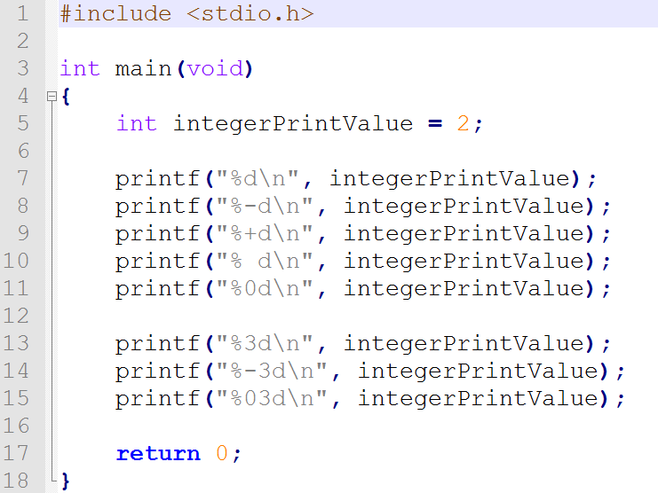
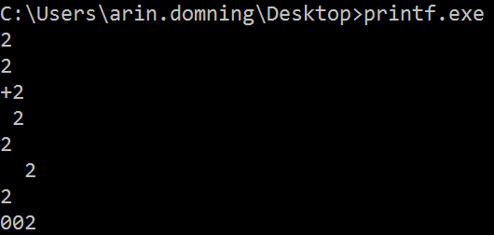
Flag Examples
C code
Output

Slide 9
Width - Optional
An integer value
Reserves X number of characters for data (Often used for padding)
Fills extra space/unused space with spaces (or 0s (zeroes) if the 0 (zero) flag was used)
Will not truncate oversized fields – X amount is a minimum

Slide 10
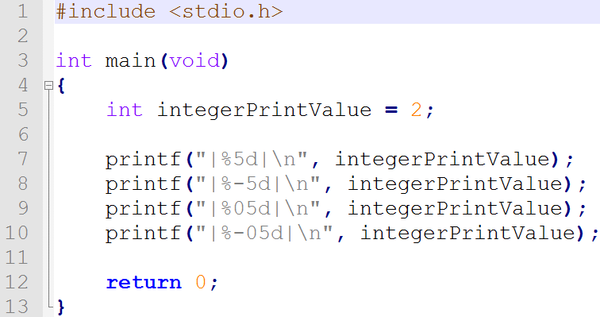
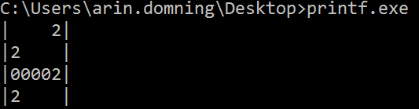
Width Examples
C code
Output

Slide 11
Precision - Optional
Period followed by an integer value
For Integer Types:
Maximum number of digits to print
If the value is shorter than the specified precision, it will pad it with leading 0s (zeroes)
For Floating Point Types:
Number of digits to print after the decimal point
6 digits by default
Rounds the extra decimal places
For Strings:
Limits number of characters that should output (Will truncate any extra characters)

Slide 12
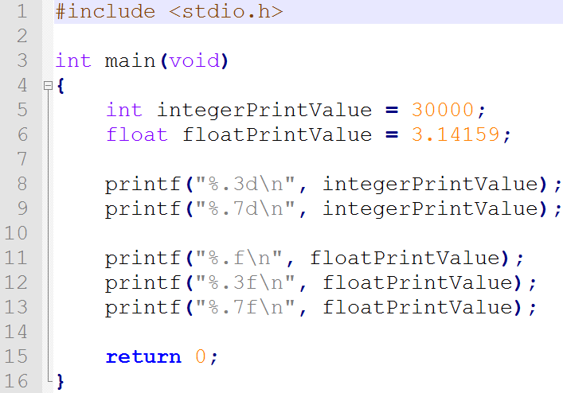
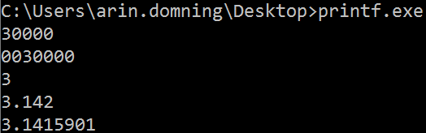
Precision Examples
C code
Output

Slide 13
Escape Sequences
Special formatting
Always begin with a \
Some examples:
\n – Newline, move to next line
\t – Tab
\\ - Backslash
\” – Quotation mark
\b – Backspace
Etc…

Slide 14
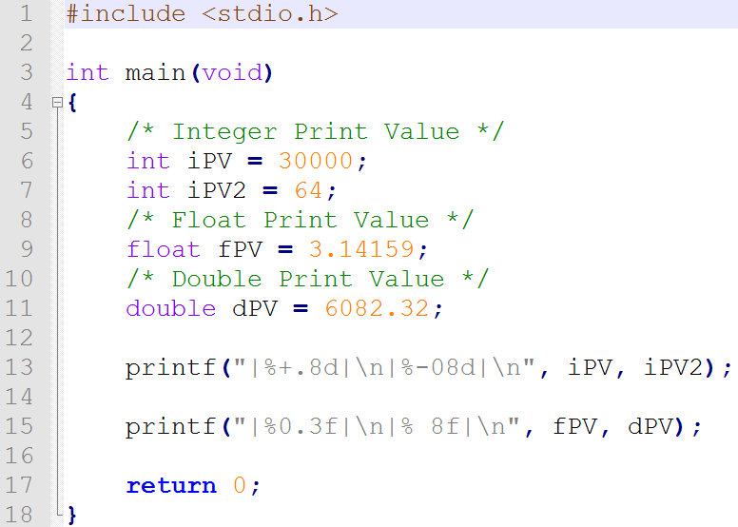
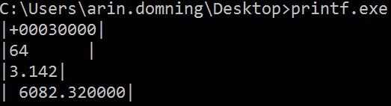
Putting It All Together
C code
Output

Slide 15
Formatted Input
scanf will be your go-to function for input.
The input abilities are limited, but you can specify the type of input you want, how many characters to read in, etc:
%[width]specifier
Width is how many characters to read in, and specifier works similarly to how it does in printf

Slide 16
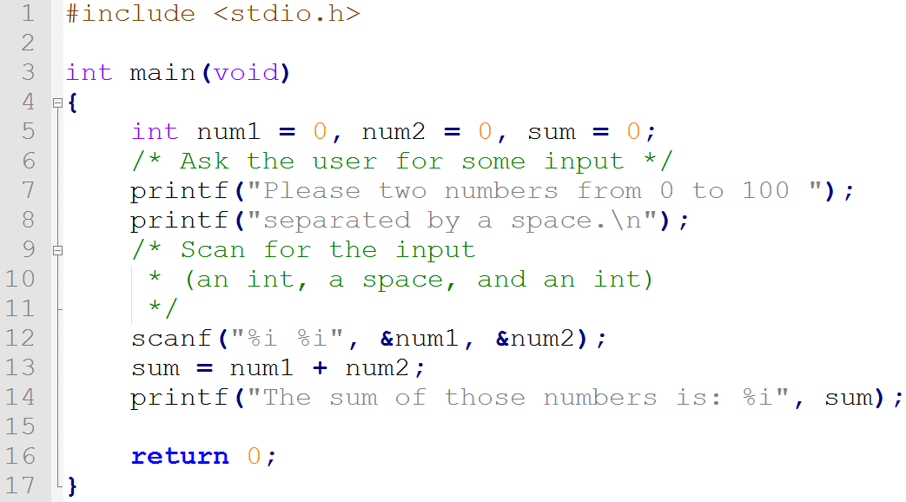

Example
C code
Output

Slide 17
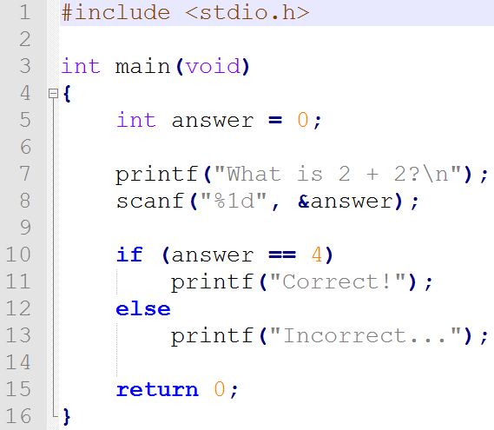
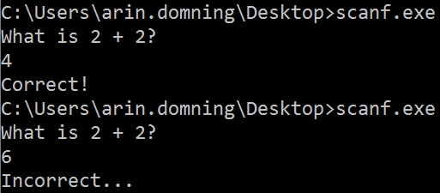
What’s the ‘&’?
& is called the address operator
Gets the address of where the data is stored
scanf needs to know the location to store the data to

Slide 18
Summary
printf is our go-to output function – it can print simple strings or variables
scanf is our go-to input function – it scans for the exact specifiers you give it and stores it
If we want to print/scan a variable, we need to provide a specifier (%d, %f, etc)
Everything else (flags, width, precision) are optional

Slide 19
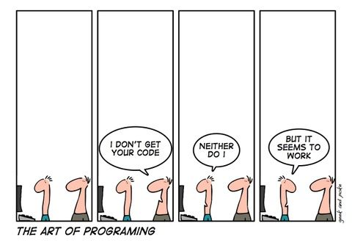
Questions?

